Slide 1

PORCH PIRATES: A DIVE INTO TRENDS OF PROPERTY CRIME
By: Daniel Espin, Robert DiFazio, Brian Lui, and Nitish Arora

Slide 2
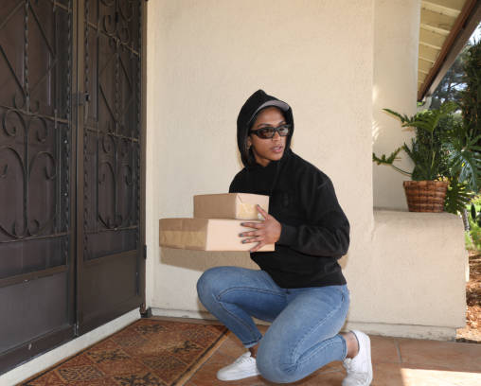
Introduction
The ongoing Pandemic has had a rise in packages being ordered due to people staying home
1.7 million packages are stolen every day, resulting a value of $25 million worth of lost goods. $5.4 Billion in 2020. (Schloov, 2020).
In 2021, over 210 million goods disappeared from porches and 64% of Americans had at least one package stolen (Cost, 2021).
We wanted to cross examine 3 major U.S cities and compare their data Pre-COVID and post- COVID

Slide 3
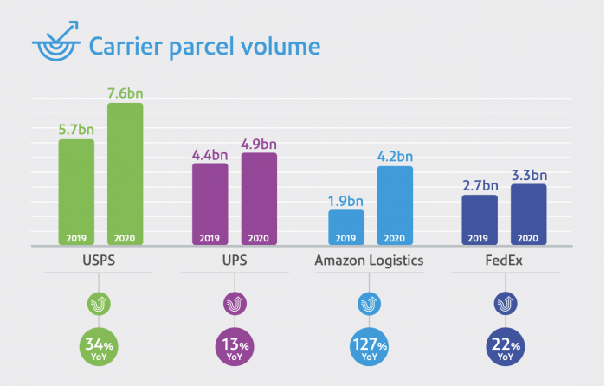
How big is the package delivery industry?
Almost 40 million packages are delivered daily in the United States
In 2020, more than 20 Billion packages were delivered in the United States
Amazon is doubling year over year and now delivers 67% of their own packages
Average US citizen receives 21 packages a year

Slide 4
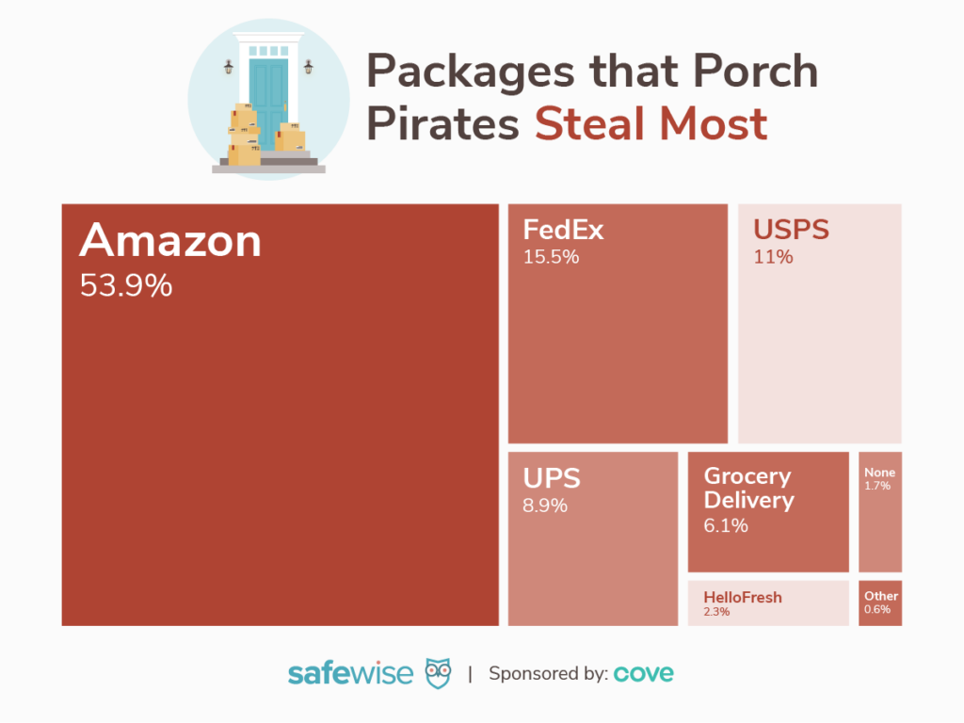
Chicago
Population: 2,739,797
One of the highest crime rates
Arrests are made < 10% of the time
More than 12 cars stolen every day on average per 100,000 people
The neighborhood of Riverdale is one of the most dangerous with 478 crimes reported annually with a population of only 13,000

Slide 5
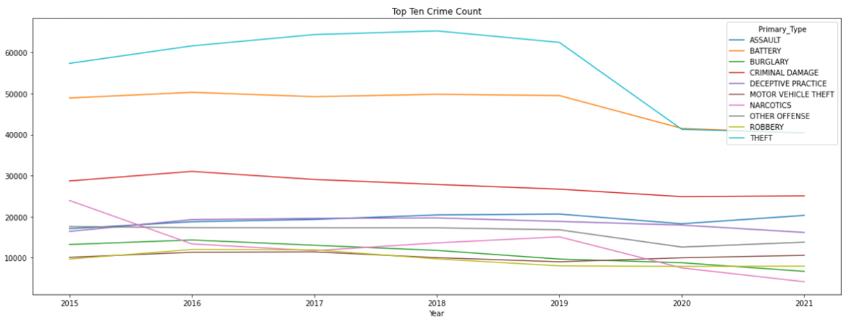
Results
Notes:
Read the bold only: A few quick interesting inferences that can be made from this view is the clear drop in thefts beginning early from 2019.
Or that Criminal Damages in red, is fairly flat since 2015 in the count of arrests made.
Other categories such as narcotics, robbery, or total crimes that are below 30000 are not as pronounced.
To get a more pronounced and indicative visual into how crime might have been impacted in Chicago we can plot the rate of change in these crimes year over year.
GO TO NEXT SLIDE

Slide 6
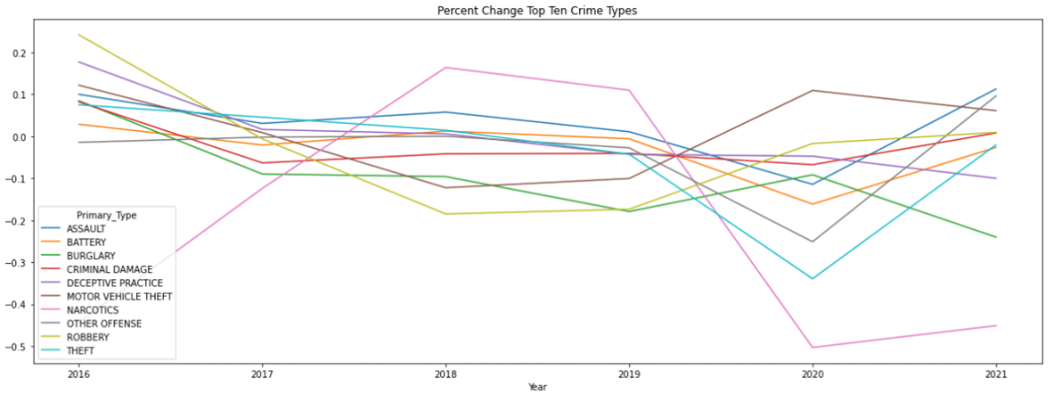
Results Continued
Notes:
This illustration is more pronounced in which we can see the rate of change in crimes through time. The rates of change are more pronounced, AND
the start of COVID in 2019 shows some interesting occurrences in the type of crime that is occuring.
Drops in types of crime beginning covid:
Theft
Assault
‘Other Offenses’
Battery
Narcotics
Rises in types of crimes after covid:
Motor Vehicle Theft
Robbery
Burglary
To validate these findings: ecofact.org notes: (https://econofact.org/crime-in-the-time-of-covid)
-Home burglaries dropped, while commercial burglaries and car thefts rose.
-Drug crimes dropped the most — by 65% — at the pandemic onset and fell again during the summer. Drug crimes saw the biggest decline of any category at the onset of the pandemic in almost all cities for which I have data – 65% on average.
One of the clearest anomalies is Narcotics, affected by Covid as noted by CWBChicago, who cover local police data in chicago:
“Interim Police Supt. Charlie Beck yesterday said officers are stopping fewer pedestrians and drivers. And their “hands off” approach is driving CPD arrest numbers to possibly historic lows.”
https://cwbchicago.com/2020/03/arrests-plummet-crime-nosedives-in-early-days-of-covid-19.html

Slide 7
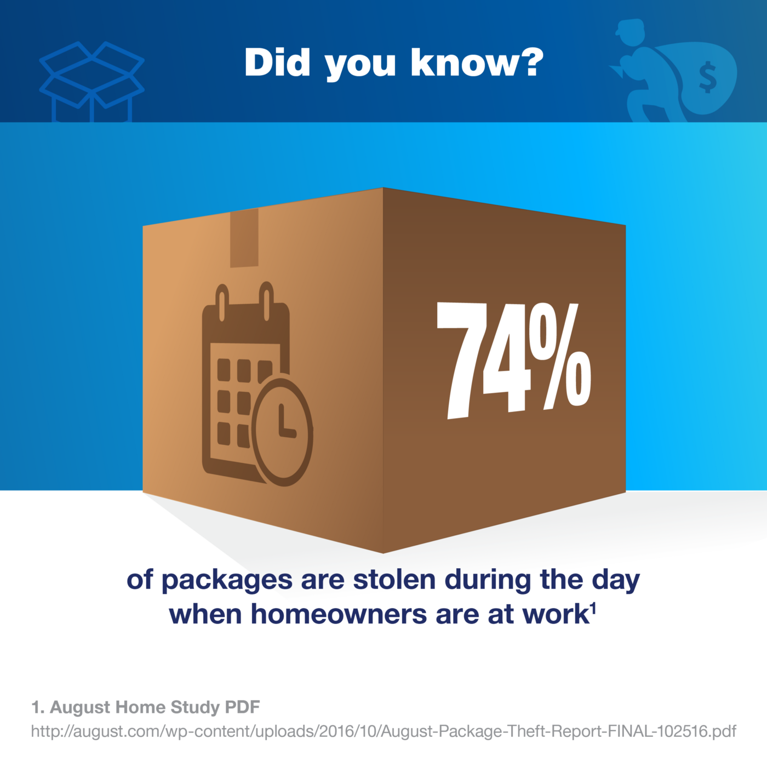
Philadelphia
Population: 1,600,000
Porch Pirating was going down before the Pandemic
Personal experience working in Philly, seeing trends in crime

Slide 8
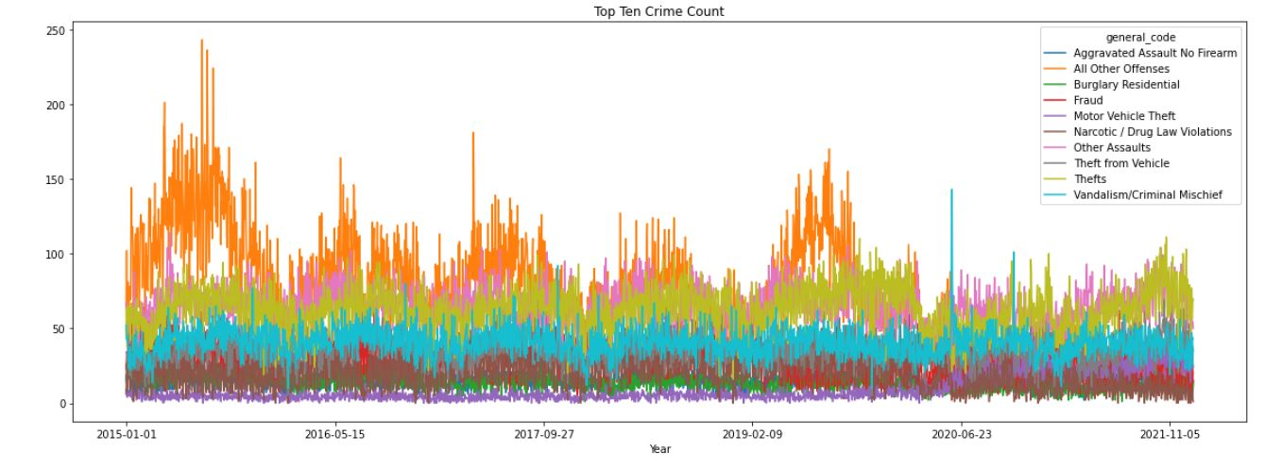
Results

Slide 9
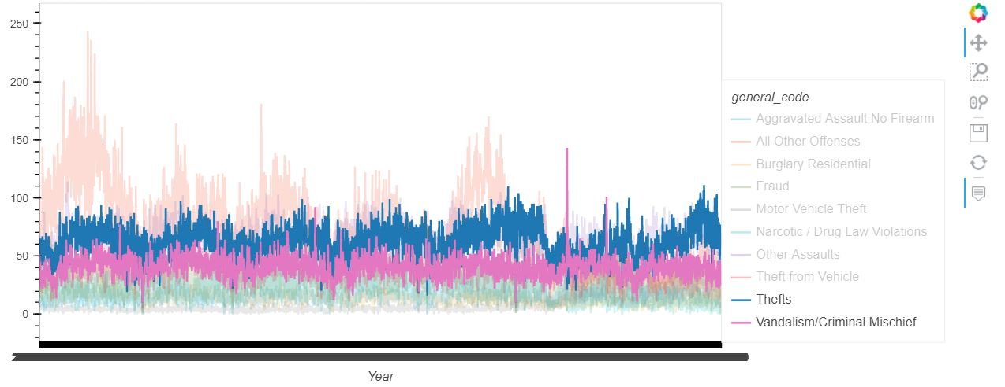

Slide 10
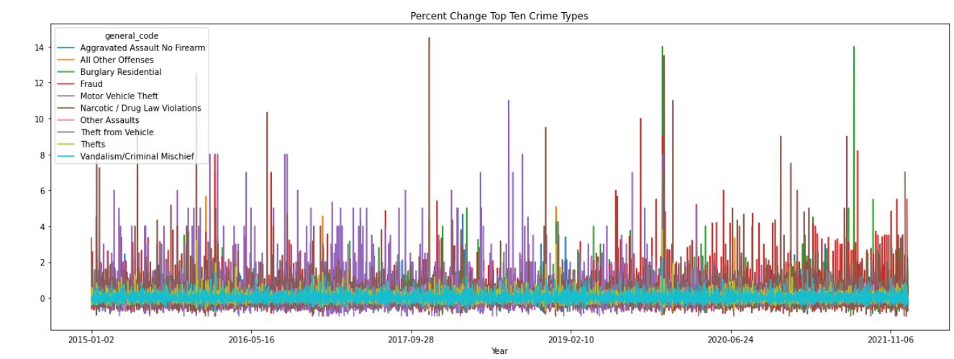
Results

Slide 11
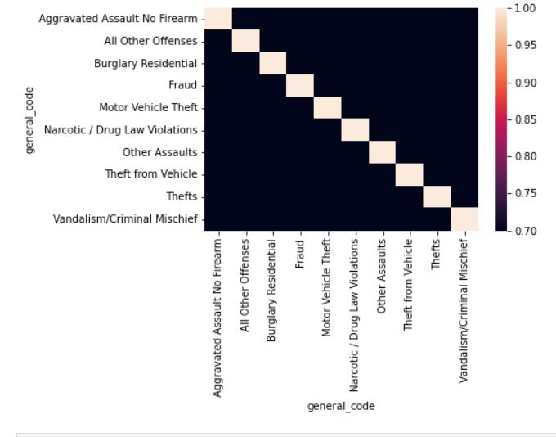

Slide 12
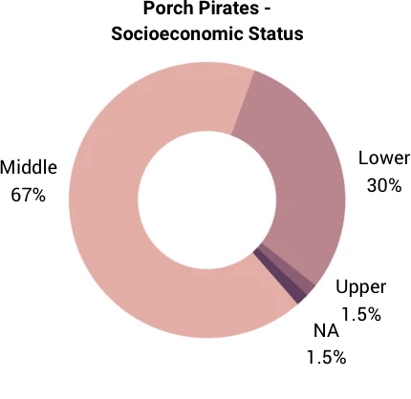
San Francisco
Population: 875,114
2nd worst city in the US for Porch Pirating
In 2021, property crimes increased by 11%, while violent crimes went up by 1%
Notes:
Out of 3 cities that we analyzed, SF population was the smallest about 1/2 the population of Philly and a quarter of Chicago yet SF is the second in the country for porch pirate rates.

Slide 13
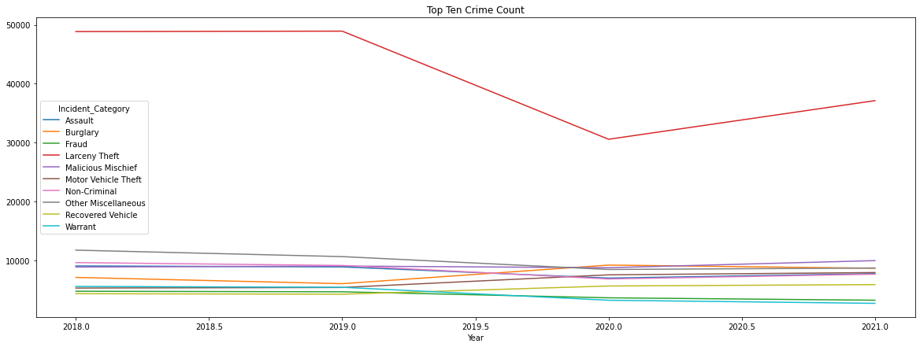
Results
Notes:
From the previous slide, San Fran is #2 in porch piracy in the US, which comes to no surprise, that Larceny Theft is the #1 crime count was in San Fran
Some assumptions as to why San Fran has such a high theft rate?
Houses are close together and close to the street so it’s easier and quicker to steal from multiple houses at a time. You can rob like 5 houses and easily run to your car, compared to running between spaced out houses, through a lawn, then running back to the car
San Fran is the ranked 4th in US metropolitan area per capita income, which could lead to more packages being delivered to houses. Also to mention, San Fran is very hilly, so who would want to hike up and down a hill when you can just order a package to your door.
This might be an interesting assumption, but out of the 3 cities we chose, San Fran had the smallest population. A smaller population means less human traffic so there isn’t as many people looking out for porch piracy.
Also, San Fran has laxed laws when it comes to theft. If the value which you have stolen is less than $950, it is only a fine of $1,000 and/or 6 months in jail, compared to Chicago ($2,500 and/or 1 year in jail) and Philadelphia (up to $10,000 and/or 5 years in jail)

Slide 14
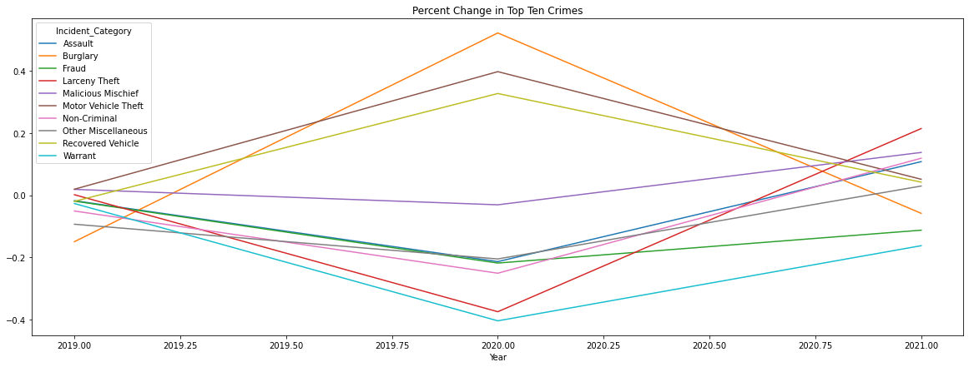
Results
Notes:
Larceny theft dramatically increased in 2020, the start of the pandemic.
Burglaries decreased probably due to the fact that more people started staying home and burglars didn’t have empty houses to rob.
Also interesting to see how Burglary and Larceny theft had inverse effects, in 2020 as burglary percentage rate decreased, larceny theft increased

Slide 15
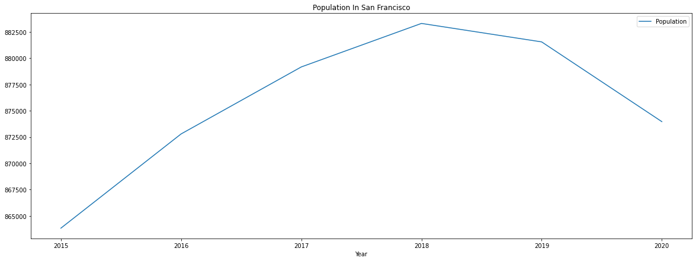
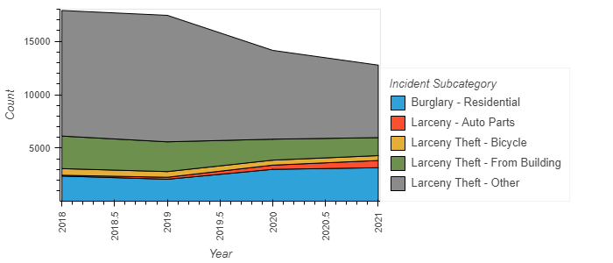
Results
Notes:
SF population is 1/2 of Philly and ¼ of Chicago yet SF is the second in the country for porch pirate rates.
Burglaries started increasing as the population decreased. Assumption is that since people are moving out the city, it’s easier to burglarize an empty house

Slide 16
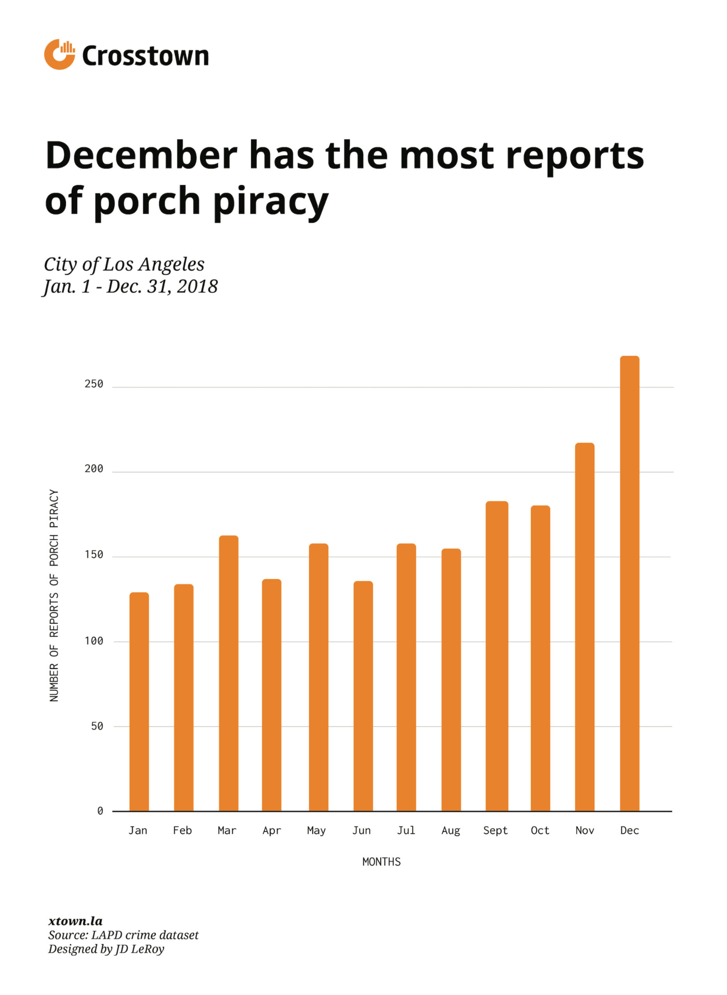
Seasons and correlation towards theft trends
Increase during November and December
Especially between Thanksgiving and Christmas
Increase in Summer 2020
Amazon packages are the most desirable

Slide 17
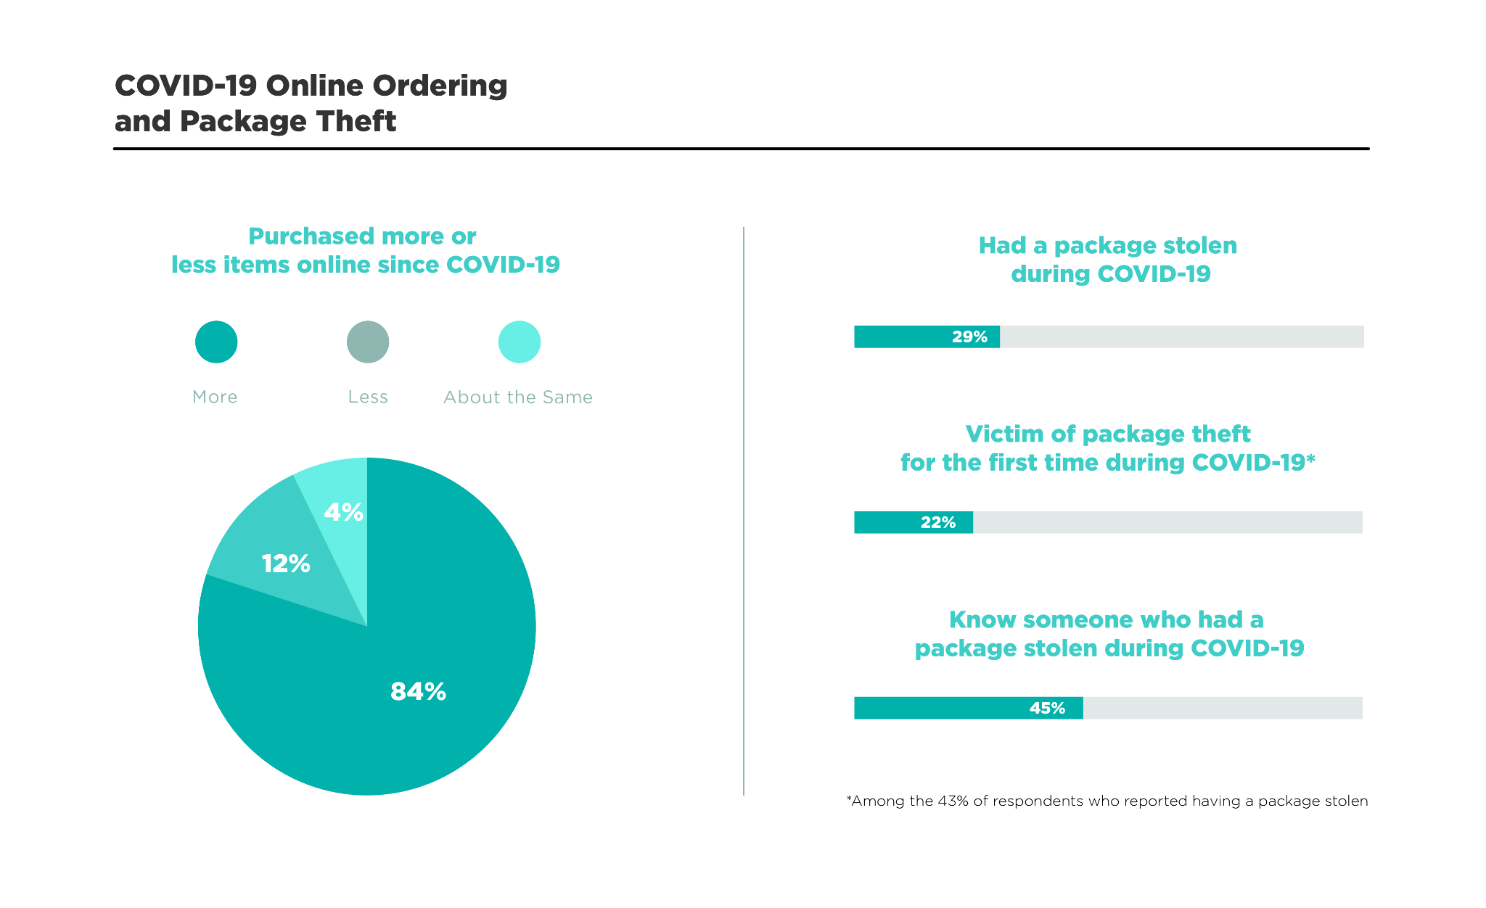
Porch Pirates During Pandemic
500,000 more daily delivered packages than before the pandemic
80 percent of deliveries are to residential customers, compared with 40 percent year prio.
Grocery deliveries have more than doubled
Household goods deliveries have jumped by 24 percent

Slide 18

Conclusion
Philadelphia crime has been remaining consistent and organized. With spikes happening due to issues with social climate.
San Francisco’s trend of Larceny theft seems to be ever so increasing since the pandemic
In Chicago, porch pirating decreased in the beginning of Covid, while motor vehicle theft spiked

Slide 19
Works Cited
https://metadata.phila.gov/#home/datasetdetails/5543868920583086178c4f8e/representationdetails/570e7621c03327dc14f4b68d/
https://data.sfgov.org/Public-Safety/Police-Department-Incident-Reports-2018-to-Present/wg3w-h783
https://crime-data-explorer.fr.cloud.gov/pages/explorer/crime/crime-trend
https://dev.socrata.com/foundry/data.cityofchicago.org/ijzp-q8t2
https://www.opendataphilly.org/dataset/crime-incidents/resource/79134de9-56fa-41f2-b529-b660aaf1539b
https://www.census.gov/quickfacts/fact/table/US/PST045218
https://nypost.com/2021/11/29/210-million-packages-were-stolen-this-year-survey/
https://www.cnbc.com/2020/01/10/package-theft-how-amazon-google-others-are-fighting-porch-pirates.html

